Slide 1
NCLB/ESEA
Updates and Allocations
Spring Fiscal Workshops 2011
Fall Creek Falls – April 28th – April 29th
Gatlinburg – May 12th – May 13th
Paris Landing– May 19th – May 20th
Pickwick – May 25th – May 26th

Slide 2
Brought to you by the
Tennessee Department of Education
Division of LEA Support and Improvement
5th Floor, Andrew Johnson Tower
710 James Robertson Parkway
Nashville, TN 37243-0375
Anita Raulston, Associate Executive Director
Brenda Staggs, Grants Manager
Carol Neiger, Grants Coordinator
Mike Taylor, West TN Regional Coordinator
Karen Munn, Middle TN Regional Coordinator
Patty Wright, East TN Regional Coordinator

Slide 3
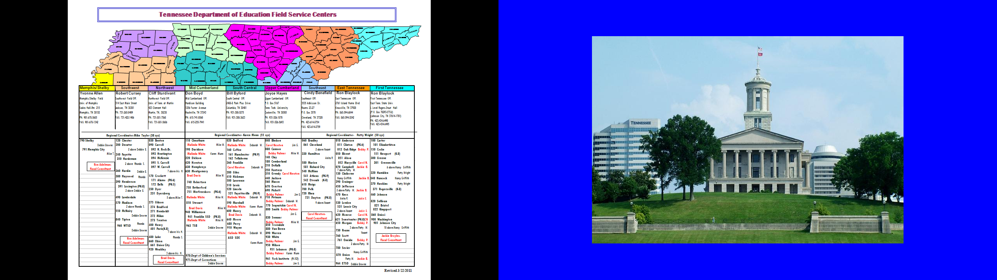
Who is on your team?
NCLB/ESEA Consultants
Fiscal Consultants
State Department of Education Staff

Slide 4
Formula Percentages Poverty
Tennessee’s overall poverty rate increased
Some LEAs decreased significantly which will impact FY12 allocations
Formula Percentages by Year-Preliminary numbers for FY12 Application (w/o Foster count revisions)
Sys # | System Name | SY 07-08 (FY 08) | SY 08-09 (FY 09) | SY 09-10 (FY10) | SY 10-11 (FY11) | SY11-12 (FY12) | LEGEND
171 | Alamo City | 19.59% | 22.41% | 21.09% | 21.83% | 24.94% | Below 15% poverty
051 | Alcoa City | 19.26% | 23.18% | 19.74% | 19.91% | 21.37% | Lost Concentration grant
010 | Anderson County | 17.10% | 19.38% | 21.74% | 20.71% | 23.90% | Never received Concentration grant
541 | Athens City | 23.52% | 28.55% | 29.52% | 28.08% | 28.44% | May receive Concentration this year; didn't in previous year(s)
020 | Bedford County | 17.28% | 19.22% | 22.25% | 19.55% | 24.53%
172 | Bells City | 23.96% | 27.68% | 25.68% | 26.73% | 23.73%
030 | Benton County | 22.63% | 26.66% | 27.76% | 26.69% | 26.92%
040 | Bledsoe County | 20.32% | 25.52% | 24.79% | 25.90% | 29.55%
050 | Blount County | 14.75% | 17.58% | 15.26% | 14.92% | 16.04%
274 | Bradford SSD | 21.42% | 21.16% | 26.96% | 24.38% | 25.66%
060 | Bradley County | 13.69% | 14.69% | 16.01% | 14.42% | 17.65%
821 | Bristol City | 17.11% | 19.85% | 21.60% | 18.13% | 21.51%
070 | Campbell County | 27.59% | 30.65% | 31.42% | 30.86% | 32.03%
080 | Cannon County | 15.98% | 17.86% | 18.87% | 18.45% | 21.15%
100 | Carter County | 19.55% | 23.74% | 26.41% | 23.24% | 24.95%
110 | Cheatham County | 10.89% | 12.84% | 10.78% | 11.19% | 13.73%
120 | Chester County | 18.01% | 21.01% | 22.02% | 21.21% | 23.54%
130 | Claiborne County | 23.28% | 27.67% | 28.98% | 26.39% | 29.83%
140 | Clay County | 22.27% | 28.07% | 31.06% | 31.03% | 32.32%
061 | Cleveland City | 20.93% | 22.52% | 24.06% | 22.16% | 26.05%
011 | Clinton City | 23.01% | 26.15% | 28.44% | 27.19% | 32.21%
150 | Cocke County | 27.95% | 30.64% | 36.69% | 30.82% | 34.05%
160 | Coffee County | 11.36% | 16.65% | 15.70% | 18.59% | 20.83%
170 | Crockett County | 18.16% | 20.73% | 19.31% | 20.24% | 23.83%

Slide 5
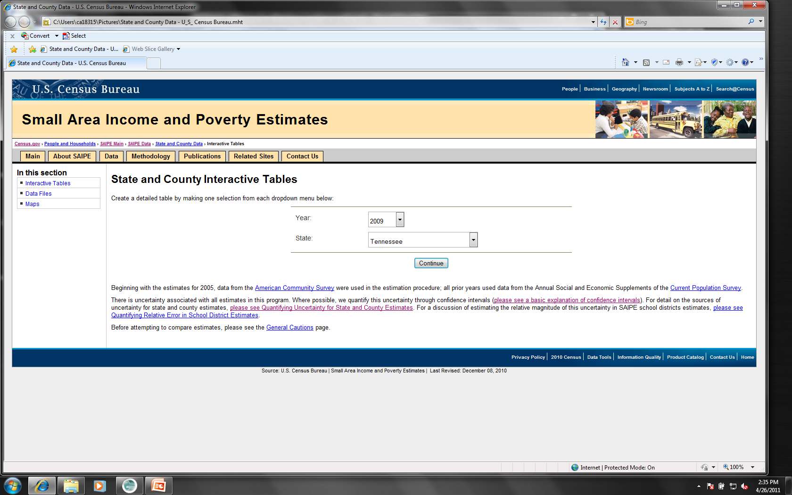
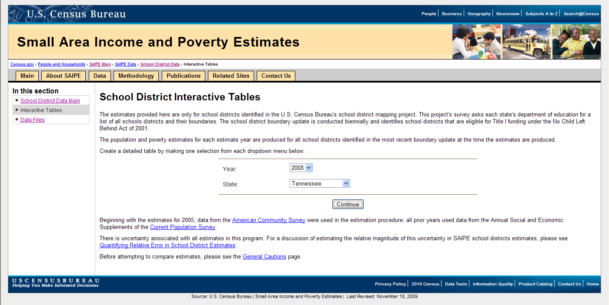
Poverty Determination
www.census.gov/did/www/saipe/district.html

Slide 6
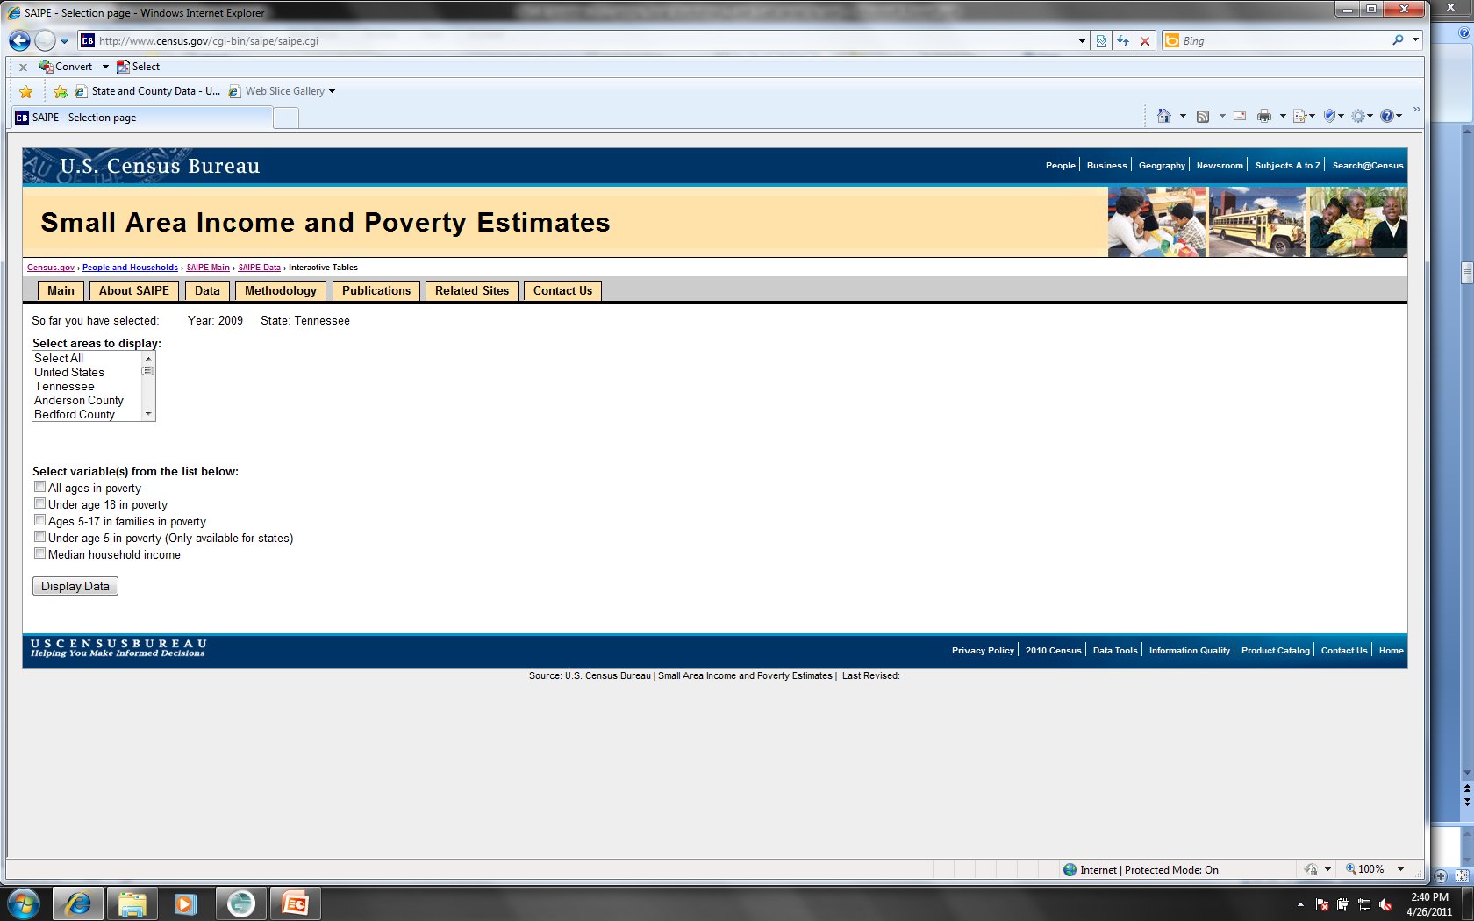
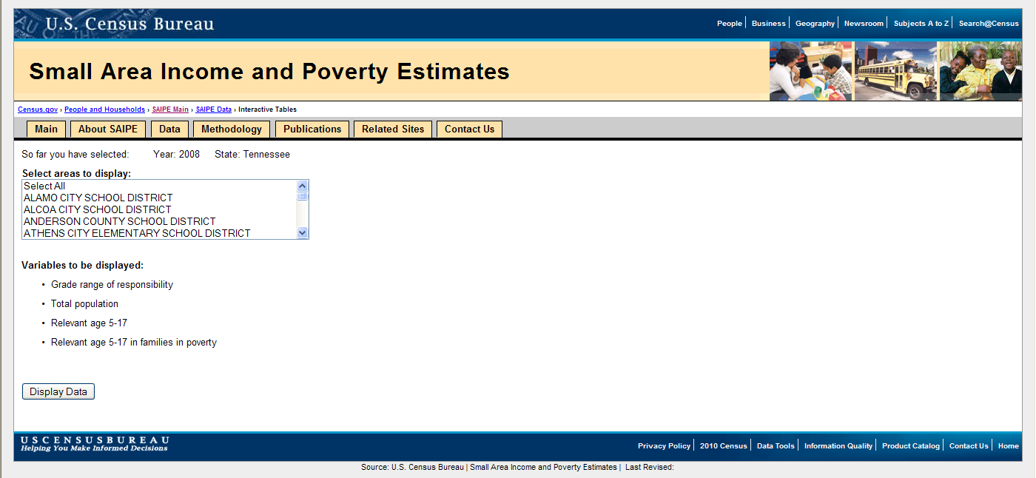
Selecting Your District
Select your district

Slide 7
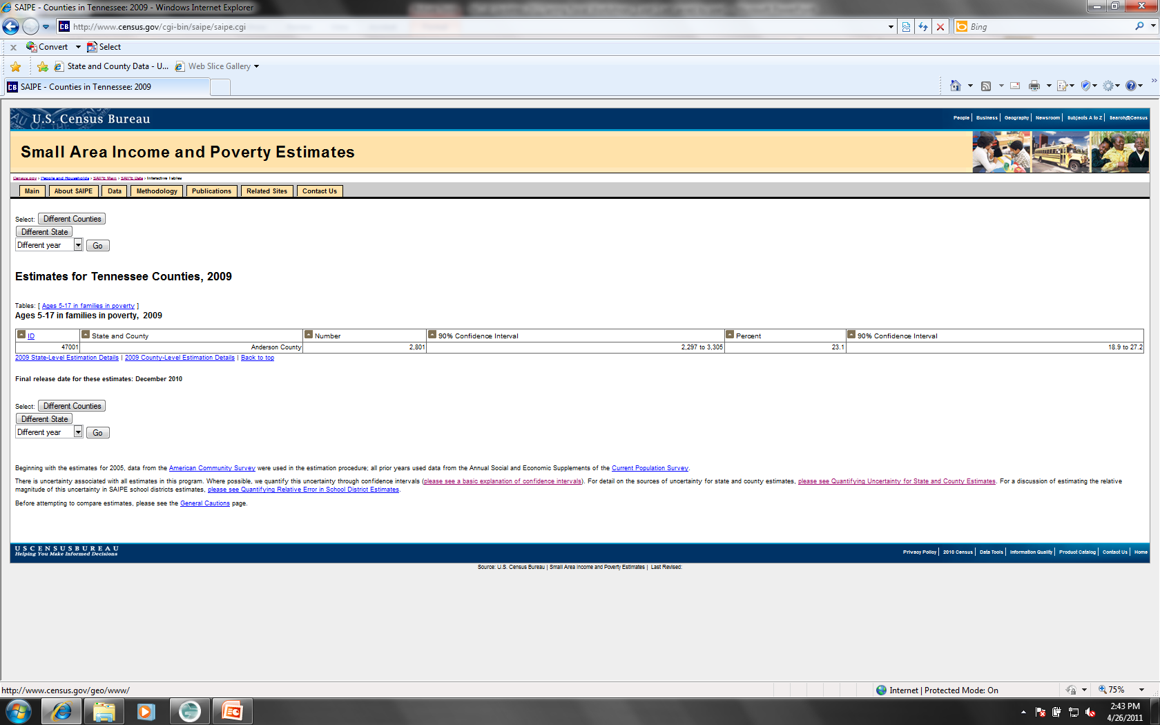
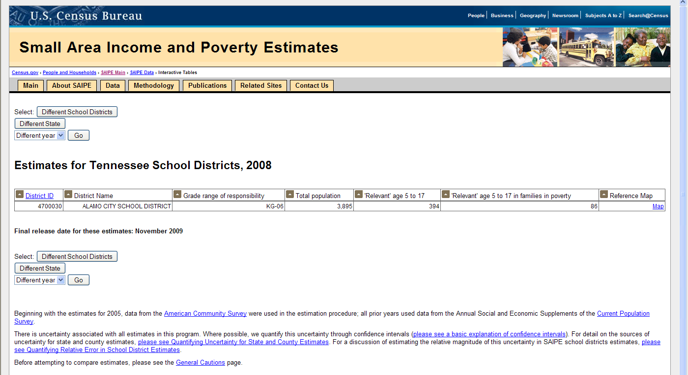
Estimates For Your LEA

Slide 8
Formula Percentages
Concentration Funds
No LEAs lost concentration funds
6 LEAs may receive concentration that have not in the past – Blount, Bradley, Fayette, Loudon, Murfreesboro City, Sullivan
Hold Harmless
No LEA went under 15% for the first time in FY12

Slide 9
Maintenance of Effort
Calculated by the TDOE based on expenditures
http://www.tennessee.gov/education/fedprog/fpadministration.shtml#Maintenance_of_Effort
4 LEAs for FY11 were in danger of not meeting
Pay attention and plan for MOE
With current trends more LEAs are in danger of not meeting MOE, especially by FY13
Spring NCLB/Fiscal Workshop presentation: http://www.tennessee.gov/education/fedprog/fppresentations.shtml

Slide 10
Allocation Trends
Title IA Improving Academic Achievement - $1.6 M increase for entire state
Title IIA Teacher Quality – Possible Reduction
Title IID Formula-Enhancing Education through Technology – Zeroed out in last budget on web
Title IID Competitive (e4TN) - Zeroed
Title IID ARRA Competitive (e4000) – ending 9/30/11
Title III English Language Learners – Level at best
Title VI Rural and Low-Income Schools – 8 new LEAs/
9 LEAs returned that were not eligible in FY11/1LEA lost funding/75RLIS/5SRSA

Slide 11
Preliminary Allocations
Title I-A and I-D, Subpart 2 released from the US Department of Education
TN formulas calculations – version 1
Team Reading
Budget ≤ FY11 will be reviewed
Achievement School District (ASD)
New Superintendent named May 10th
District will start next school year-allocations “as is” for 141 LEAs

Slide 12
Preliminary Allocations
Title IID . . .
Most recent indications that Title IID funding has been zeroed out for 2011-12.
TDE Division of LEA Support and Improvement is
searching for options to keep the e4TN courses
available to LEAs and schools.

Slide 13
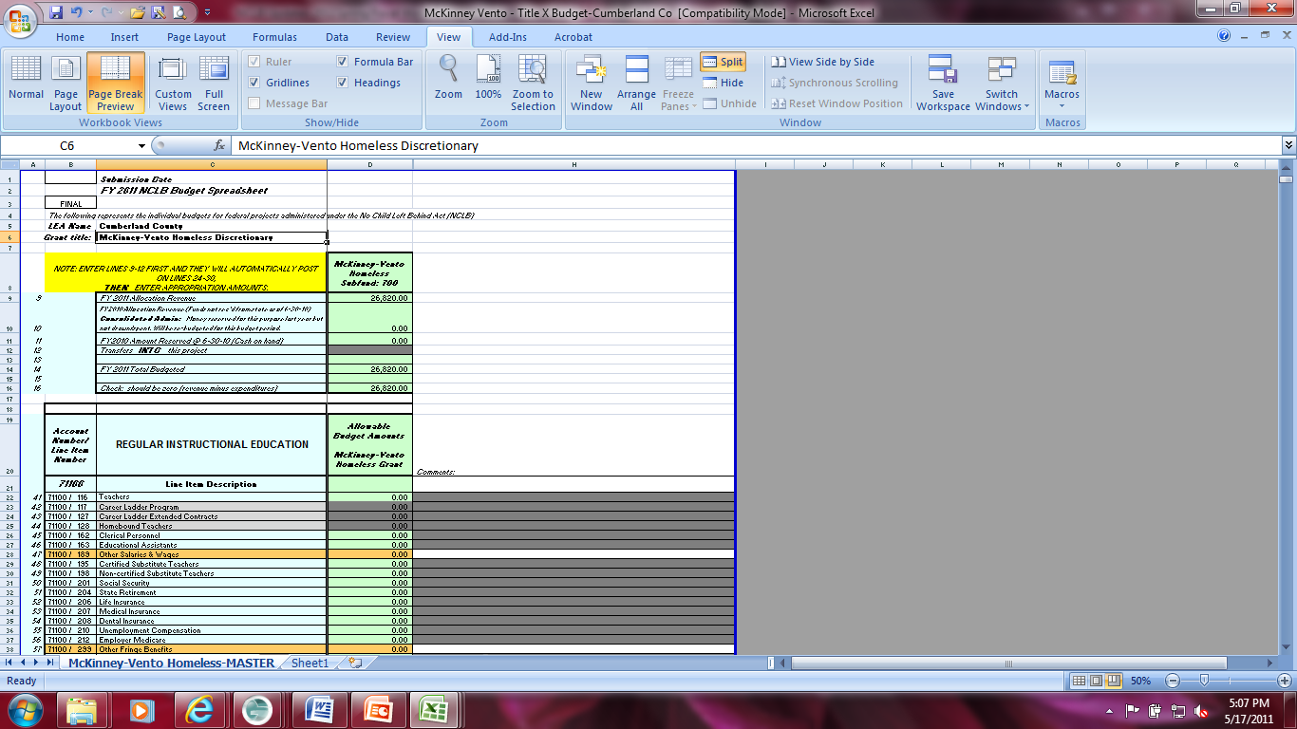
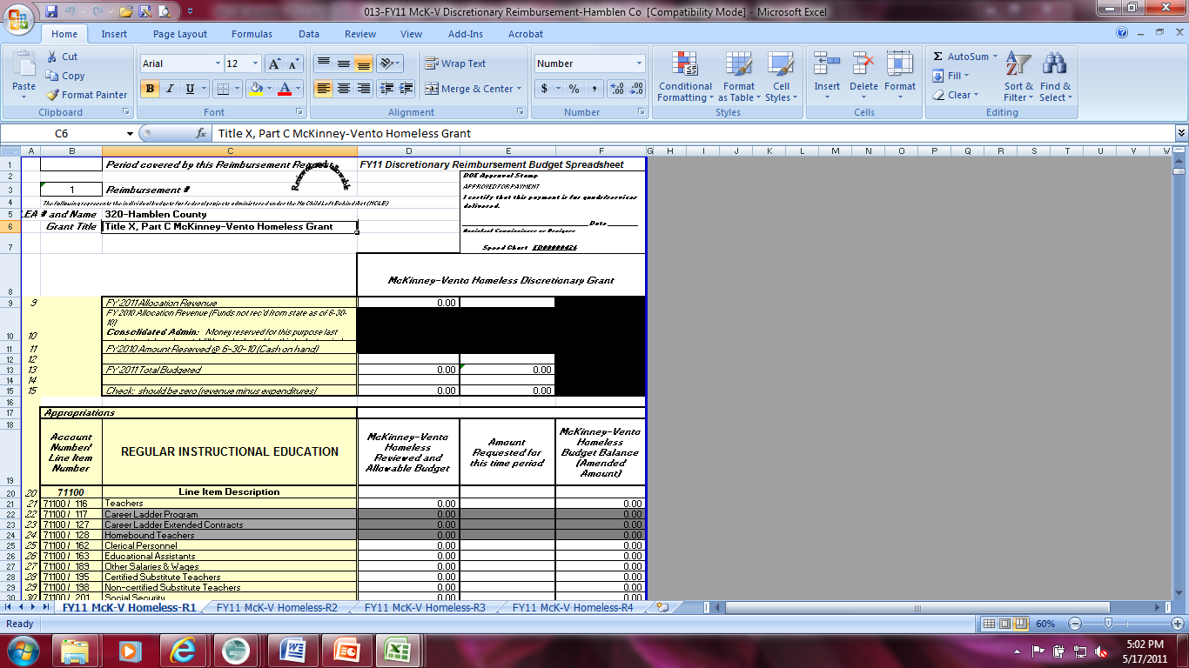
Discretionary Grants
COMPETITIVE
Different budget spreadsheet and amendment sheets
Lavendar on left-FY12
Customized reimbursement spreadsheet-multiple tabs for
numerous requests
Yellow on left
Focus of upcoming Presidential Budget proposals

Slide 14
Budget Worksheet
Preliminary due in May to ESEA/NCLB consultant
Final due by October with final allocations
All Titles listed including Consolidated Administration

Slide 15
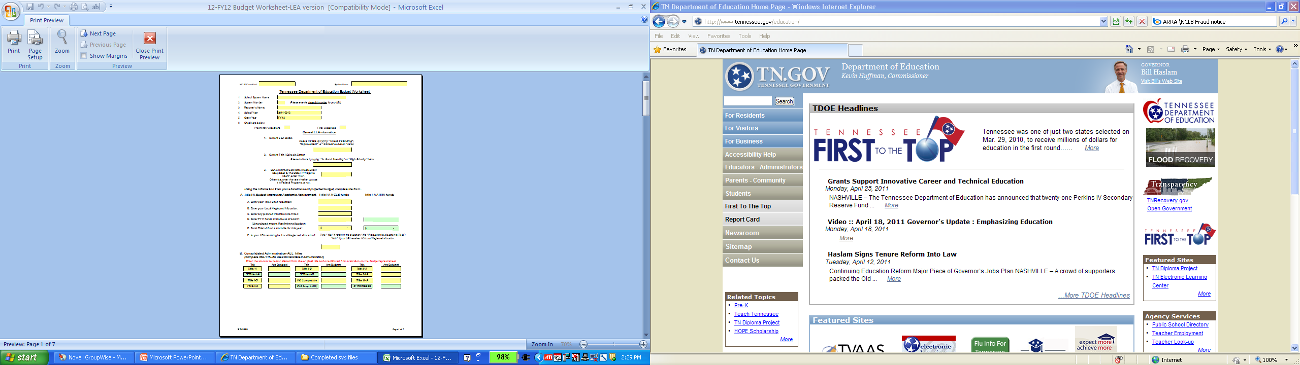
Budget Worksheet

Slide 16
Budget Spreadsheet
Preliminary due in May to ESEA/NCLB consultant
Final due by October
New “EZ” form
All Titles listed
NCLB/ESEA and ARRA funds,
Consolidated Administration
(Special Note: Title IID Competitive (e4000) is not on the budget spreadsheet and Title X Homeless FY11 is on– FY11 approved budget remains until 9/30/11)

Slide 17
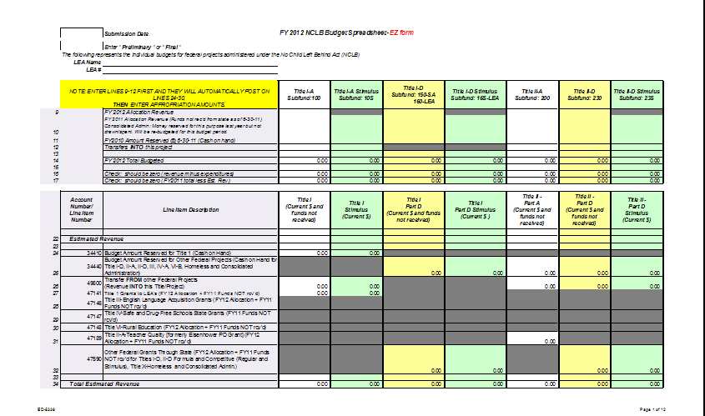
Budget Spreadsheet

Slide 18
Budget Amendments
May be needed with an addendum
Changes greater than 10% to any sub-category (individually or cumulatively)
Requirements:
Cover letter with affected projects checked
Justification form for each affected title
Signed by LEA program director and ESEA consultant
Specific description of changes
Budget spreadsheet (File 013)

Slide 19
Carryover for FY12 Budget
From Line 10 of the budget spreadsheet
Subtract 6/30 payments or
payments closest to 6/30 or
payments with comments reflecting 6/30 expenditures

Slide 20
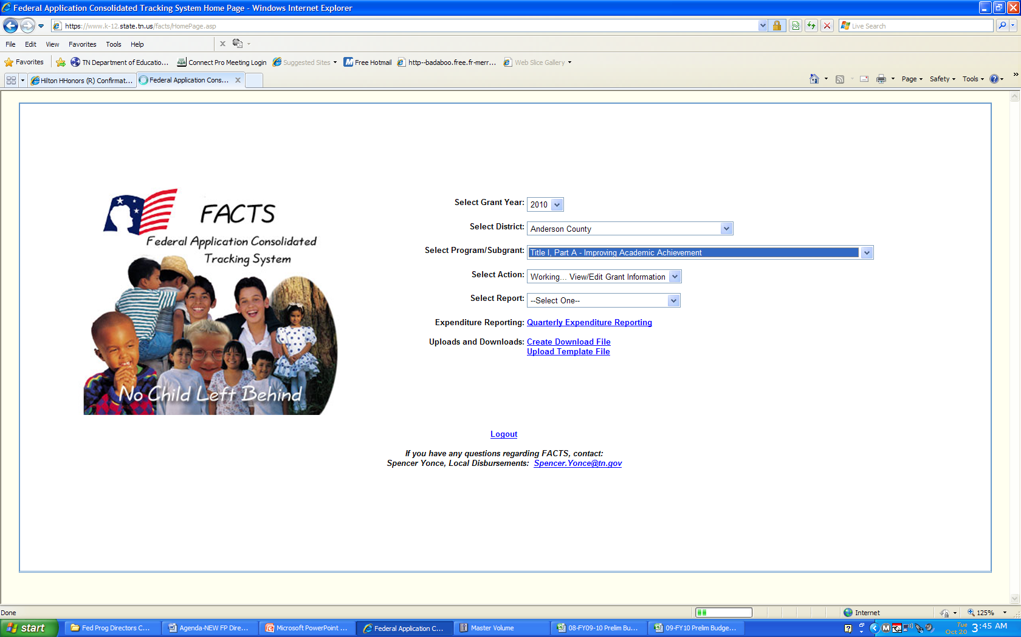
Facts

Slide 21
FACTS (Federal Application Consolidated Tracking System) https://www.k-12.state.tn.us/facts/
Receive access to allocations
Make Payment requests
Enter Expenditure Reports
Check status of funds and transfers

Slide 22
Memos - When needed and Examples
Payment request examples:
Request for Alcoa City for ELL expenditures
(Fiscal Agent Memo)
Payment for SES expenditures
Payment for Private School equitable services
Expenditure Reporting examples:
Expenditure for expenses incurred between
3/1/11 and 3/31/11
Expenses for Alcoa City for ELL
(Fiscal Agent Memo)

Slide 23
Monitoring and Adjusting with FACTS
https://www.k-12.state.tn.us/authorize/
Monitor requests and payments
Remember the 45-day window at the end of each quarter for reporting
Use FACTS reports for oversight
Grant Status Report
Grant Transaction Report

Slide 24
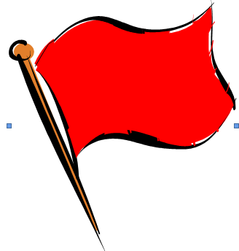
FACTS “Caution Flags”
-Drawing down funds without reporting expenditures
-Reporting expenditures without drawing down funds
-Not drawing funds for months at a time
-Not complying with Cash Management Information Act (CMIA)

Slide 25
E-reporting
Changes put in place to:
Avoid duplication of data entry
Gain required OIG oversight
Requirements:
Collaboration between Federal Programs and
Finance LEA personnel
More info on payment requests
Quarterly e-reporting submissions
Reminder -
Quarterly expenditures for 3/31 Quarter were due by April 15, 2011
$$$ stops at the end of the work day

Slide 26
E-reporting Observations
No quarterly report submitted
Expenditures in line with no $$$
Expenditures exceeding budget with no amendment
Line item expenditures disappearing between quarters

Slide 27
Status Page
http://www.state.tn.us/education/fedprog/fpadministration.shtml
One is for deadlines from July-December
One is for deadlines from January-June
Check red cells for needed corrections
Email NCLB/ESEA consultant and Brenda Staggs to correct
“Go GREEN” to receive funds on time

Slide 28

Status Page Caution Flags…
Gold Flags
Pending deadlines
Item not ready for LEA
Nothing required YET
Red Flags
Deadlines Missed
Items Incomplete
Out Of Compliance
Possible Funds Withheld

Slide 29

ARRA
Drops DEAD 9/30/2011
Expend
or
Release
All other FY10 Titles drop dead

Slide 30

Title IV
FY10 Dropping Dead 9/30/2011
Some LEAs transferred $$$ into Title IV but have NOT expended
Expend
or
Release

Slide 31
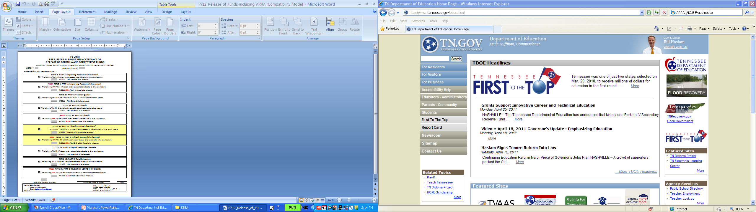
Release of Funds form

Slide 32
September 30, 2011 Carryover
Title I + ARRA Title I = Total Title I 15% CAP
Title III 25% CAP
Request an ARRA Waiver: Check box on page 3(A) of the Consolidated Application
Carryover Availability is based on FACTS

Slide 33
Late Reporting for Expenditure Reports
Forms page: http://www.tennessee.gov/education/fedprog/fpforms.shtml
Send an email to Brenda Staggs or NCLB/ESEA consultant detailing what needs to be done (Use form attached)
Identify titles, dates and revisions needed
Changes will be made within two weeks

Slide 34
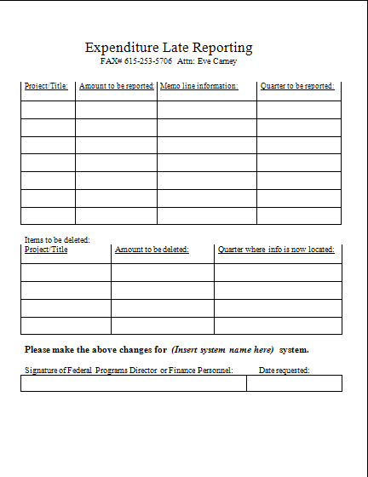
Use the displayed form for either/both Expenditure Reporting or deletions of incorrect Expenditure reporting

Slide 35
Reporting Requirements - ARRA
Title II-D ARRA Grant Awards must be included in the June 30, 2011 Quarterly Report.
DUNS numbers must be registered annually at www.ccr.gov. Keep your LEA number current.
Vendors: Individuals or entities OUTSIDE your LEA – would not include salaries, benefits, reimbursements to employees for travel.
All documentation should be kept at LEA and maintained separately.

Slide 36
Section 1512 Reports. . .
Report for quarter ending June 30, 2011:
Due to your NCLB Consultant June 18, 2011
Report must be certified by Director of Schools no later than June 25, 2011.
To certify your quarterly report, logon to FACTS/eReporting: https://www.k-12.state.tn.us/eReporting/Reports.aspx
Report: NCLB ARRA Q2 Section 1512 Report

Slide 37
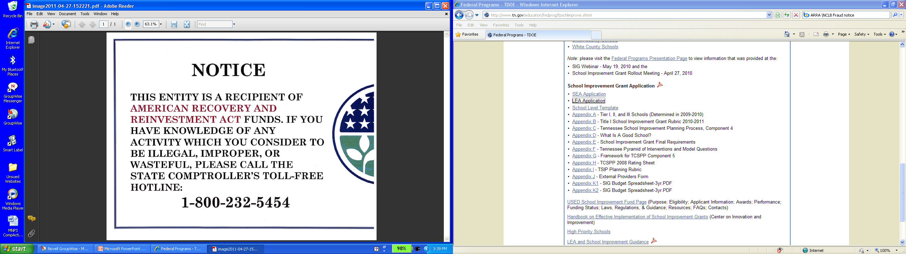
Fraud Notice
ARRA Fraud Notice
Recipients of awarded funds made available under the Recovery Act shall promptly refer to an appropriate inspector general any credible evidence that a principal, employee, agent, contractor, sub-grantee, subcontractor, or other person has submitted a false claim under the False Claims Act or has committed a criminal or civil violation of laws pertaining to fraud, conflict of interest, bribery, gratuity, or similar misconduct involving those funds.

Slide 38
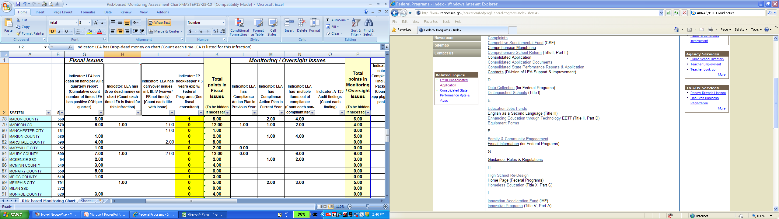
Risk Based Assessment
Master Overview explanation: http://www.tennessee.gov/education/fedprog/fppresentations.shtml

Slide 39
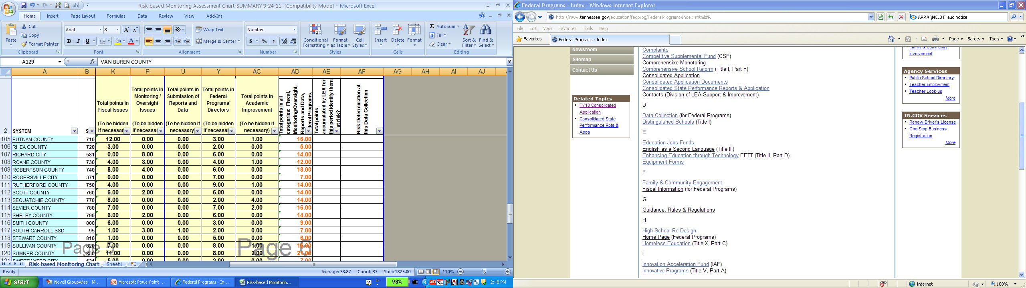
Risk Based Assessment
Summary

Slide 40
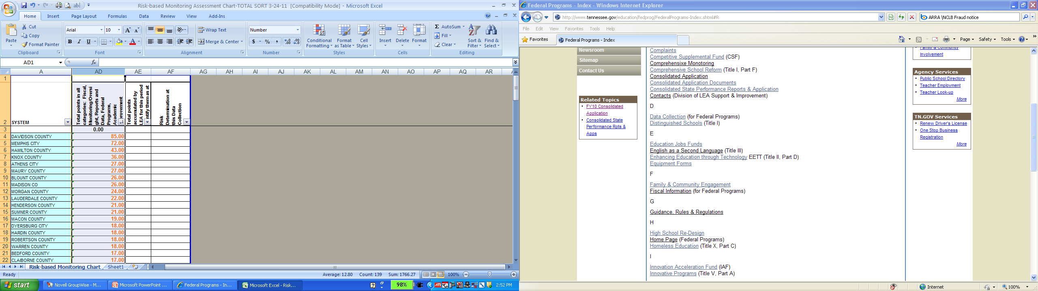
Risk Based Assessment
Total

Slide 41
Mike Taylor, West TN Regional Coordinator Karen Munn, Middle TN Regional Coordinator Patty Wright, East TN Regional Coordinator
Division of LEA Support and Improvement
Office of Federal Programs
Updates

Slide 42
Comparability
Staffing from state and local funds for Title and non-Title schools must be comparable
Reported to Federal Programs as of October
Important to consider as LEAs plan for 2011-12

Slide 43
Monitoring
ARRA requirement
Monitor 1/3 of LEAs annually
Monitor 2/3 of ARRA funds annually
3 year monitoring cycle for most LEAs
Largest LEAs every year

Slide 44
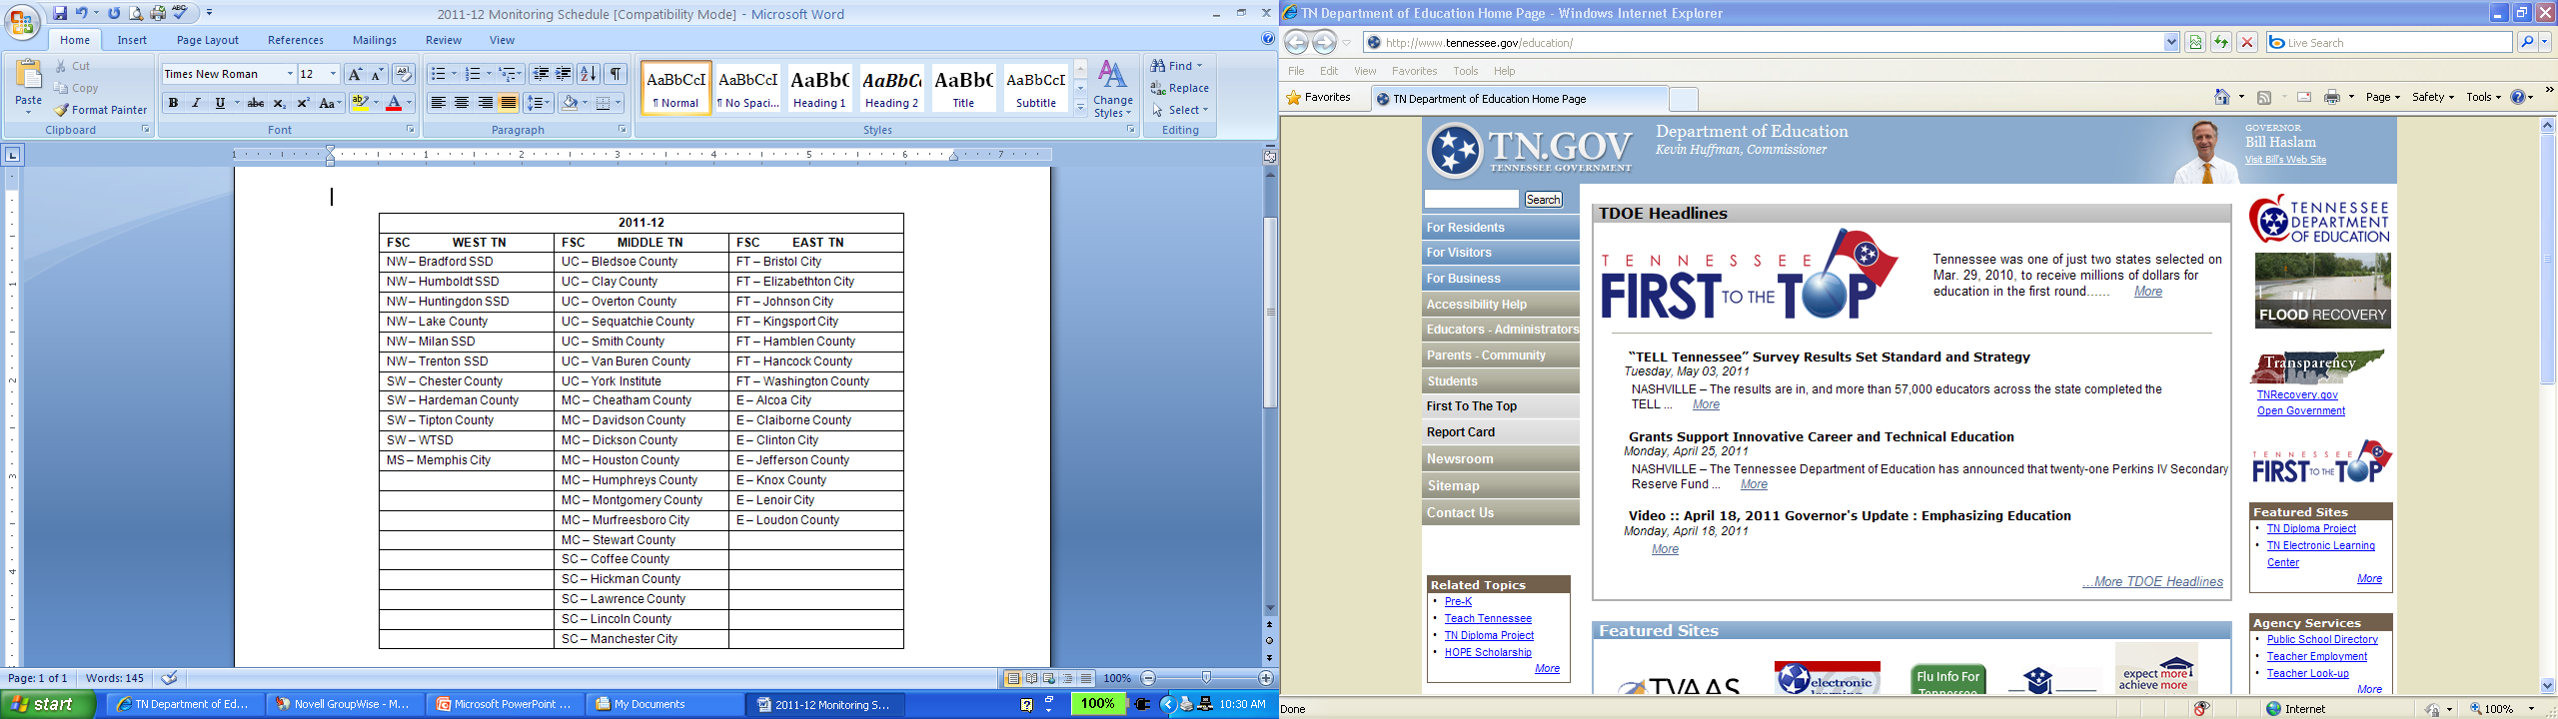
LEAs to be Monitored

Slide 45
Monitoring–Common Fiscal Findings
Approved federal programs budget is not reflected in the local software.
Lack of accountability for inventory/equipment
Personnel
Certifications of Employment
PARs - Personnel Activity Reports
Unallowable Expenses/Excessive Costs
Appropriate Record keeping
Equitable services to private schools

Slide 46
Monitoring–Common Fiscal Findings
Samples of Unallowable Expenses:
Microwaves/refrigerators/coffee pots
Curtains
Student incentives
Polo shirts with school logo
Notebook (binders)
Translators
Unreasonable food

Slide 47
Monitoring–Audit Findings
Title I and Title IIA
Unallowable expenditures
Not addressing core academic subjects
Not effectiveness of classroom teachers
Class size reduction teacher not supplemental
Little academic support for placement of CSR teacher
Reasonable? Necessary? Allocable?

Slide 48
Monitoring–Common Program Findings
Title IID
Required 25% of allocation not expended for allowable professional development activities
Unexpended set-aside for PD from prior year not expended
If zeroed out and 25% of FY11 IID is not expended on PD but IID funds are expended on equipment, etc. other local funds would have to make up the difference
Will be ZEROED out with no other FY12 allocation
Please note: TDE Division of LEA Support and Improvement is searching for options to keep the e4TN courses available to LEAs and schools.

Slide 49
Consolidated Administration
All applicable funds contribute
Reasonable/Proportional amount
$1, $5, $10 is not reasonable

Slide 50
Application Timeline & Submission
May to assigned ESEA/NCLB consultant and uploaded to the ELC
May 27 due in Nashville for processing
June 7-10 Team Reading
Problems uploading to ELC???
Is Firefox Mozilla installed on your computer?
Alert ESEA/NCLB consultant and Brenda Staggs

Slide 51
Mandated Operating Procedure
Title I schools – application this spring sets the Title I list for SY2011-12
http://www.tennessee.gov/education/fedprog/fpadministration.shtml
Changes to schools – opening/closing are reported to:
Kimberly Jackson, Executive Director
School Approval and Data Services
6th Floor, Andrew Johnson Tower
710 James Robertson Parkway
Nashville, TN 37243-0375

Slide 52

Questions
Thank you for your time and attention!

